Slide 1
How to improve the gameplay and user experience of FPS games in the field of scenery design
Lu Huitong
Information Technology
Supervisor: Isabella Beyer
Second supervisor: Gert Hillringhaus

Slide 2
Main Content
Introduction and Motivation
Related Background
Research Approach
Final Discussion and Conclusion

Slide 3
Introduction and motivation
Introduction
FPS (First-person shooters)
Popular game type, increasingly developing
First impression, Scenery design
It is the visual that get the players interested in the games in the first place (Addo, 2017).
Making effort to improve it.
Attract users in an early stage

Slide 4
Introduction and motivation
Motivation
I, personally, am keen on FPS games
Scenery design plays an important role.
Scenery design problems are available currently.
Profit and fame of games will be guaranteed.

Slide 5
Related Background

Slide 6
Related background
FPS game
Full name of First Person Shooter
Traditional -> Adding new elements
Category:
PvE: Player vs Environment
PvP: Player vs Player
Battle Royale: Start with no equipment, search weapons in the map, kill every opponent to win

Slide 7
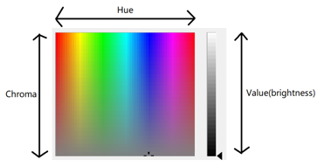
Related background
Color Psychology
A study of human behavior in terms of different colors
Three elements of color:
Hue: main properties of color
Brightness: brighter or darker
Chroma: intensity of color in an image.

Slide 8
Related background
Color Psychology
RGB Color Model:
An additive color model that red, green and blue lights are added together in various ratios to produce a broad array of colors. (Hirsch, 2004)
Human Reaction to colors
About 62-90 percent of the assessment is based on colors alone. (Singh, 2006)
Multiple factors

Slide 9
Related Background
Other Information
Game Engine: lays the ready-made framework for game developers to create and build video games.
Different engine creates different scenery design
C#: multi-paradigm programming language, commonly used in Unity3D.
ISO9241: an international standard decided by IOS, as a reference in scenery design of games.

Slide 10
Research approach

Slide 11
Research approach
Procedures
Game collection
Game analysis
Possible factors
Game stage design
Testing
Result and analysis

Slide 12
Game collection
Market Situation
Six websites of FPS ranking has been analyzed. (Available in references)
Here is the list of the most popular FPS games
Apex Legends
Battlefield 1
Call of Duty: Black Ops ||||
Counter-Strike: Global Offensive
Fortnite
Overwatch
PlayerUnknown’s Battlegrounds
Tom Clancy’s Rainbow Six Siege
FOR QUESTIONNAIRE

Slide 13
Game Collection
Questionnaire
This questionnaire aims to collect the ideas from those regular game players and their personal views on specific games.
For different games, several specific questions are asked to get a more detailed results.
The questionnaire is available in Appendix A.

Slide 14
Game Collection
Questionnaire
Sample number: 38
Male/female ratio: 28/10
Games | Numbers(times of chosen)
Tom Clancy’s Rainbow Six Siege 11 | 11
Counter-Strike: Global Offensive | 16
Overwatch | 13
Battlefield 1 | 4
Apex Legends | 7
PlayerUnknown’s Battlegrounds | 8
Fortnite | 2

Slide 15
Game Collection
Questionnaire
To make the research easier, we should divide these games into two types.
Tom Clancy’s Rainbow Six Siege
Counter-Strike: Global Offensive
Overwatch
Battlefield 1
PlayerUnknown’s Battlegrounds
Apex Legends
Fortnite
Two-teams FPS fighting game
?
Battle Royale game

Slide 16
GAMe analysis
Two-teams FPS fighting game
Some valuable and critical questions:
In the game, have you ever died because the model colors of enemies are not bright enough?
Tom Clancy’s Rainbow Six Siege 81.82% agree
Counter-Strike: Global Offensive 87.5% agree
Overwatch 30.77% agree

Slide 17
GAMe analysis
Two-teams FPS fighting game
Some valuable and critical questions:
In the game, have you ever suffered visual fatigue when having stared at one specific dark or bright place for too long?
Tom Clancy’s Rainbow Six Siege 72.73% agree
In the free-suggestion part, some testers argued that although the stage is real and elaborate, some parts of the map are extremely dark.

Slide 18
GAMe analysis
Two-teams FPS fighting game
Some valuable and critical questions:
Do you think it is necessary to make a hardcore FPS game very real? Or you can accept some aid from graphics design?
50% agree and 50% disagree

Slide 19
GAMe analysis
Battle Royale Games
Some valuable and critical questions:
In the game, have you ever missed some items on the ground because the color or texture of items are so similar to the floor’s?
50% agrees (PUBG and Apex Legends)

Slide 20
GAMe analysis
Battle Royale Games
Some valuable and critical questions:
Deciding whether to add outlines on items and cars
87.15% and 62.5% agrees(PUBG)
Deciding whether to add outlines on enemies
About 25% agrees
Some testers claims that the scenery is sometimes dark.

Slide 21
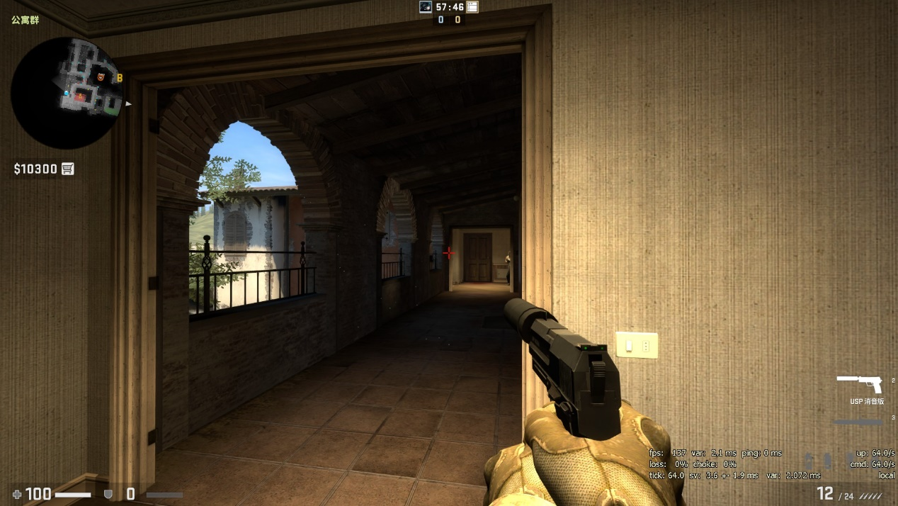
POSSIBLE FACTORS
Two-teams Fighting Games
Model color/background color(texture)
Light condition
Visible model size
Small distractions

Slide 22
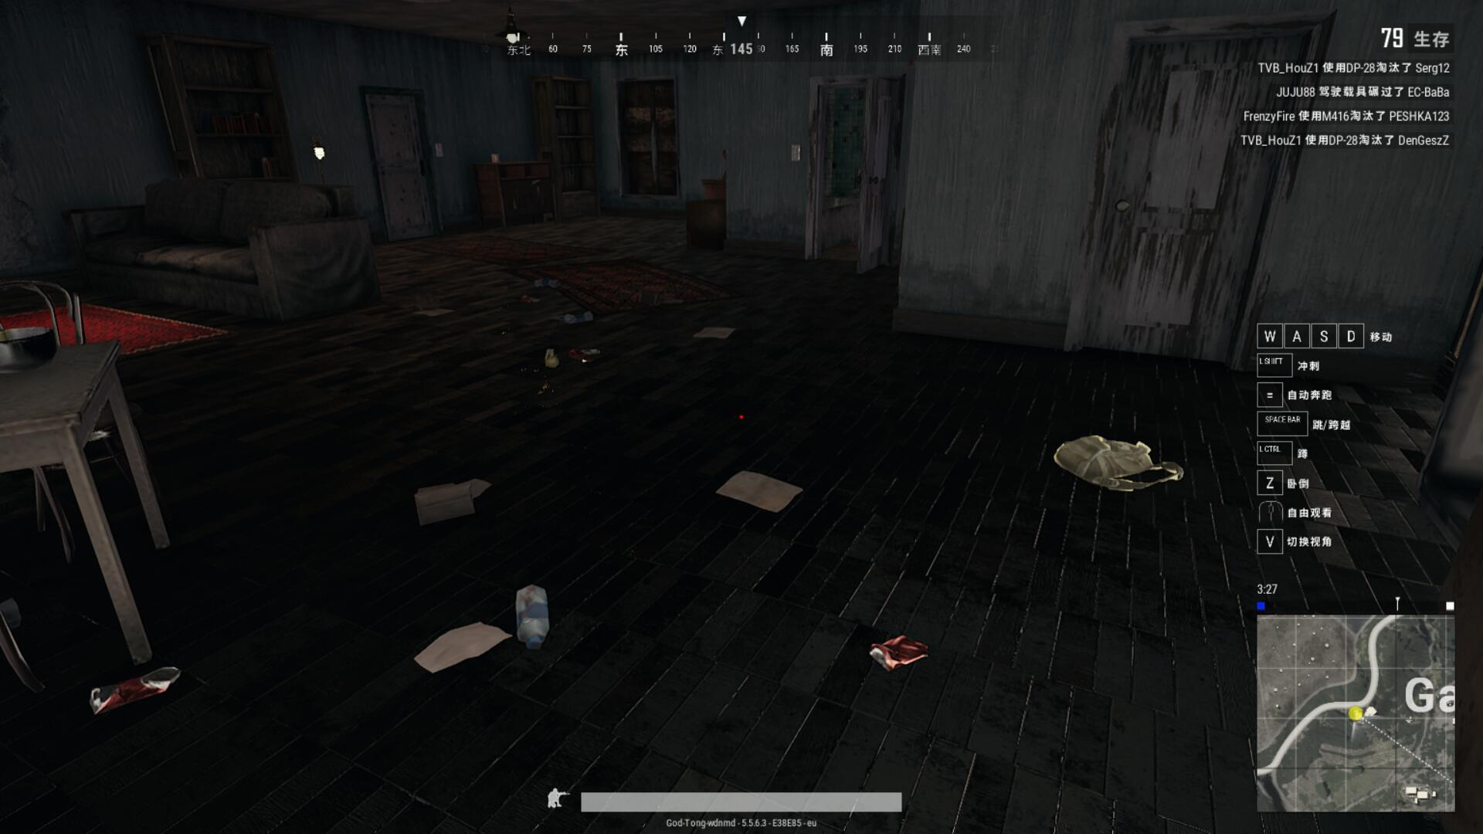
POSSIBLE FACTORS
Battle Royale Games
Item color/Ground color(texture)
Light condition
Outlines

Slide 23
Game stage design
Unity3D
Unity3D is used in the game design part.
The scripting language is C# to control the events and scenes.
Standard Assets are downloaded from Unity store. The games use the materials (textures, controllers) inside.

Slide 24
Game stage design
CSGO Situation
A game show is rather easy

Slide 25
Game stage design
PUBG Situation

Slide 26
Testing
General Information
Tester number: 3
Tester genders: 2 males, 1 female
Tester ages: 21-22
Testing environment: normal room light, normal sitting posture, about 65cm from screen
Testing time: Evening between 19:00 – 21:00 (regular gaming time)

Slide 27
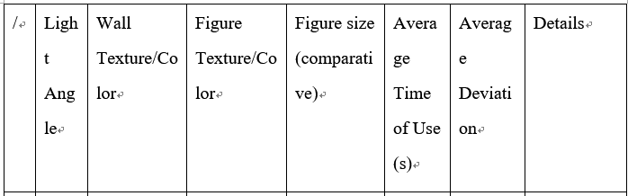
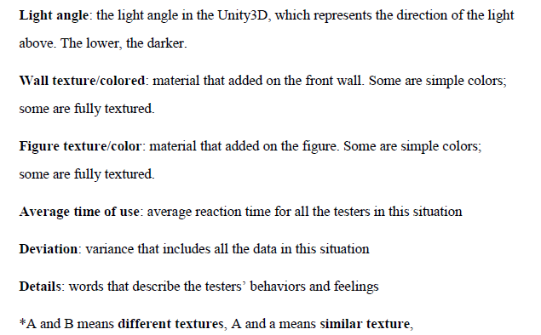
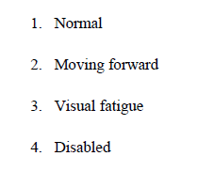
Result and analysis
CSGO Situation
P35

Slide 28
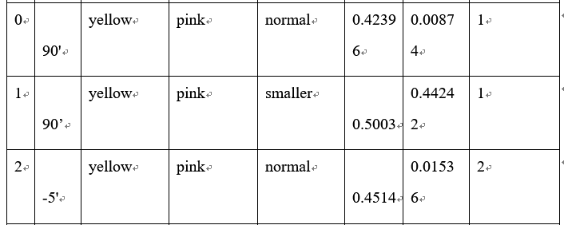
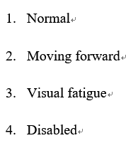
Result and analysis
CSGO Situation
The player can distinguish well if the texture is simple and clear.

Slide 29
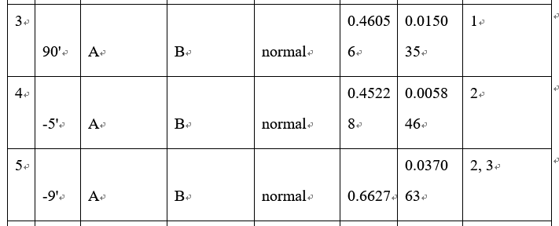
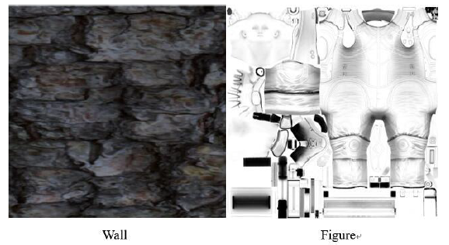
Result and analysis
CSGO Situation
With a slightly darker environment, the players will intuitively put eyes closer to the screen to make the reaction

Slide 30
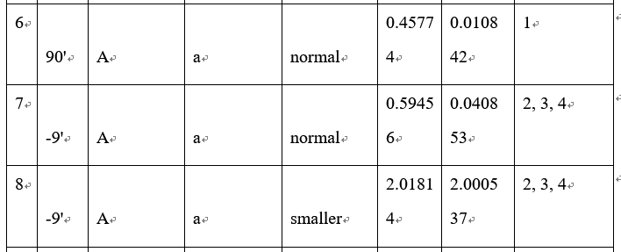
Result and analysis
CSGO Situation
-5’
In the extremely dark stage, the testers sometimes become disabled to accomplish the mission.

Slide 31

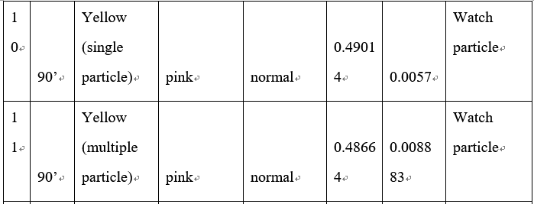

Result and analysis
CSGO Situation
Instant reaction times keep a high standard.
The testers tend to unconsciously watch the small points floating in the sky
Most of the testers feel shocked and uncomfortable.

Slide 32
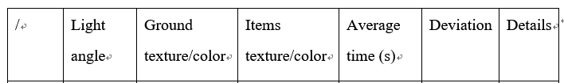
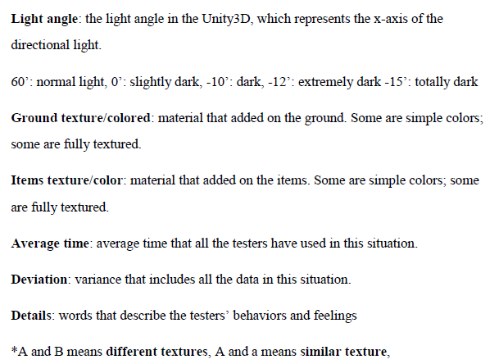
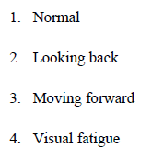
RESULT AND ANALYSIS
PUBG Situation
p40

Slide 33
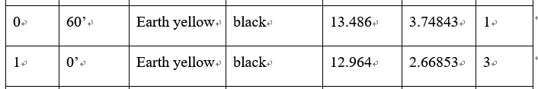
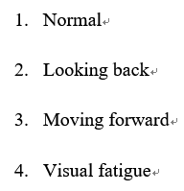

RESULT AND ANALYSIS
PUBG Situation
The testers move forward and look closer to the screen.

Slide 34
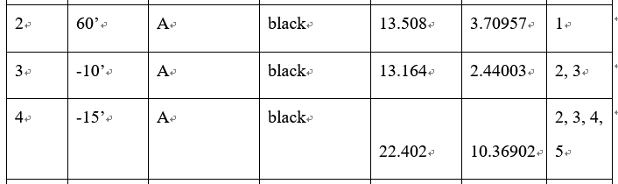
RESULT AND ANALYSIS
PUBG Situation
If the light goes to -15’, the testers are usually disabled to finish the mission.

Slide 35
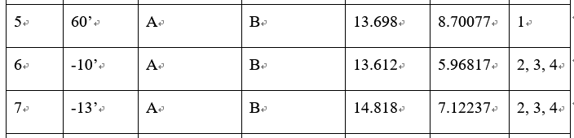
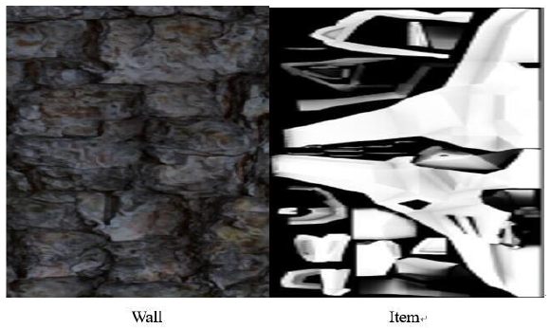
RESULT AND ANALYSIS
PUBG Situation
From a favorable light condition (60’) to a bad light condition (-13’), the performance becomes increasingly worse, but not so apparent.

Slide 36
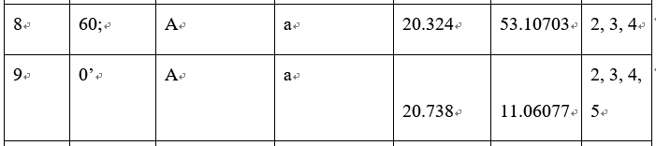
RESULT AND ANALYSIS
PUBG Situation
In 0’ light, which is only slightly dark, the tester even cannot finish the mission.

Slide 37

RESULT AND ANALYSIS
PUBG Situation
a self-emissive material is added on each item, clearly highlighted.
The shadows and beams are frequently changed and presented in the screen, causing a dazzling effect.

Slide 38
Final discussion and conclusion

Slide 39
Final discussion and conclusion
Comprehensive Discussion
Scenery design is extremely important(questionnaire)
70% regards graphic and scenery design as the most important impression on a game
75% choose to buy a game because of its graphic design
70% thinks the scenery design will affect their in-game performance
Texture/colors(background and figures, ground and items)
Lightness
Distractions
Outlines(clear enough?)
Not compulsory, all the games should firstly follow their original design style
There are several complex elements, therefore, many tests should be conducted before the game publishes.

Slide 40
Final discussion and conclusion
Conclusion
For all these factors, light condition, texture, and color play rather critical roles.
Light condition -> brighter
Color/textures -> brightness and contrasts
Outlines and special effect -> carefully controlled and implemented
These possible elements together makes a favorable scenery design.
One mistake will possibly result in a negative situation.
This bachelor thesis is guideline for game developers, reminding them critical factors, to help them develop more remarkable game with fantastic scenery design.

Slide 41
Final discussion and conclusion
Limitation
Still some games not researched
Other complex functions and effects are not implemented
Other potential factors not realized from research

Slide 42
Final discussion and conclusion
Outlook
One research cannot cover every aspects, relative thesis is scarce, closer and more detailed research is needed
New games publish, new problems will emerge.
More complex functions can be implemented to get a more accurate conclusion.

Slide 43
Thank you for listening
Questions?

